Slide 1
D-Signal Telecom & IT Co.
شركة الإشارة الرقمية للاتصالات وتقنية المعلومات
Company Profile

Slide 2
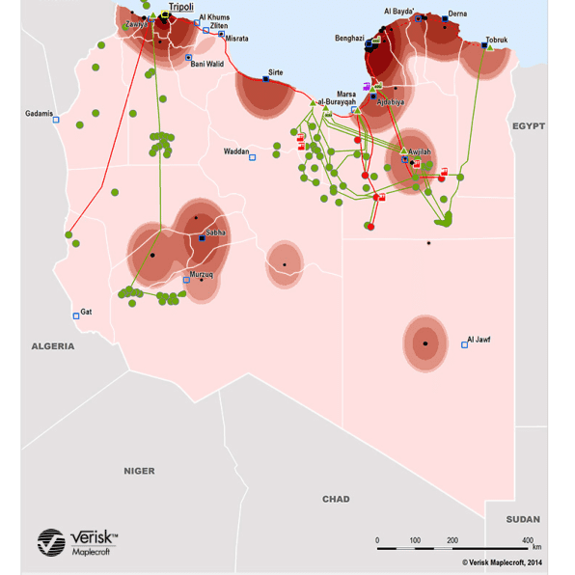
Background & History
DIGITAL SIGNAL (D-SIGNAL) Telecom & IT Co. is a private Libyan company newly established after Libya stability steps took place in Y2021 participating in activities related to Telecom Monitoring Solution, Big Data Anylytics, and, Digital Transformation projects in Libya. The company is originated from Signal Telecom & IT Systems (STIS) (www.signal-tele.com) which was established in Y2005 by a team of experienced professionals in telecom. Through the years, the company became one of the leading system integrators in Libya offering engineering and integration services of telecommunication and information technology products to customers in telecoms and oil and gas industry.
STIS was involved in a wide variety of activities offering a comprehensive integrated service to address every type of client requirement and have the capability to deliver turnkey solutions. This includes: telecommunication, control, and IT systems delivered to a large customer base of: oil companies, public authorities, government and private organisations in Libya. Our mission is to grow into the largest telecommunication integration services in Libya.
STIS expertise covers:
Feasibility Study
Engineering
Procurement
Installation
Commissioning
Product Support
Training
When you choose STIS as your contractor here is our key points:
Market leadership as system integrator in Libya.
Continues Technical Support guaranteed through manufacturers who placed their thrust in STIS.
Independent company who is committed to deliver the optimum solution with no ties to a specific manufacturer.
Professional company dealing with high-class products and high skilled professional personnel.
Service contracts can be offered with on-call services.

Slide 3
Mission & Vision
Mission
D-SIGNAL is an independent company whose international partners recognise the fact that the company is fully committed to deliver total solution that can only suit and comply with customer requirements. Therefore, as a system integrator we, truly, put the customers’ satisfaction the highest measure in choosing the product that we offer. D-SIGNAL has the depth knowledge, capability, and fully commitment to deliver the optimum solution.
D-SIGNAL always focuses and keep update knowledge on high growth in voice, data and multimedia networking markets, providing a broad range of communication systems, integration services and skills. The company offers the services of a system integrator with comprehensive turnkey solutions including System Design, System Integation, Procurement, Installation Commissioning, System Support and Multi-disciplinary Program Management.
Vision
To participate in innovative technology solutions and dive into the future of digital life granting better living style for Libyans in future.

Slide 4
TECHNOLOGY SOLUTIONS
Revenue Assurance
Cost Reduction
with Assurance Slice Management
Big Data Analytics
Value Added Services & FINTECH
Revenue Generation Solutions
Process Automation
(Digital Transformation)
Machine Learning & Data Processing
OSS/BSS Workflow & Business Process Automation Enablement

Slide 5
Managed services
Radio Systems
Satellite
Optical Fibre Systems & Networks
Telemetry & SCADA
Digital Microwave Links
SDH: STM-1, STM-4, STM-16
PDH: 1st, 2nd, 3rd
Point-to-Multipoint Systems
HF/VHF/UHF Radio Systems-Mobile/Fixed
TETRA Systems
Rural Telephony System and Mobility Solutions
Infra Red Data Transmissions Links
Spread Spectrum Radio Systems
Inmarsat – Mobile & fixed
Fixed VSAT Networks
Television Distribution Systems
Single Mode/Multimode Cabling and termination
Structure Cabling
Fibre Transmission Equipment
Short Haul / Long Haul
SDH: STM-1, STM-4, STM-16
PDH: 1st, 2nd, 3rd
FTTX
Point-to-Point and Networking Systems
Oil & Gas Pipeline Integrity Monitoring Systems
Radio Based Remote Control & Monitoring

Slide 6
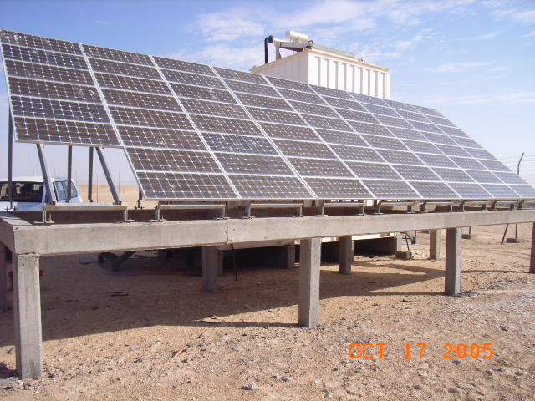
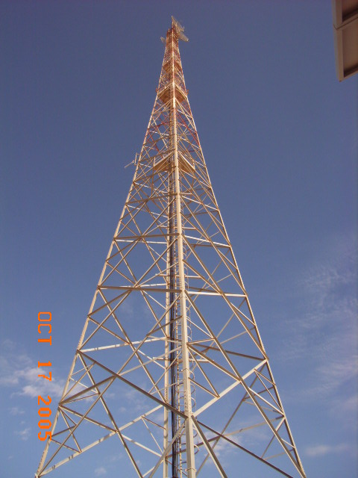
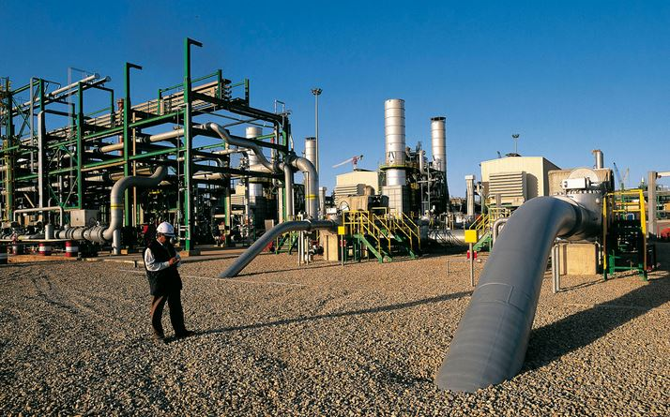
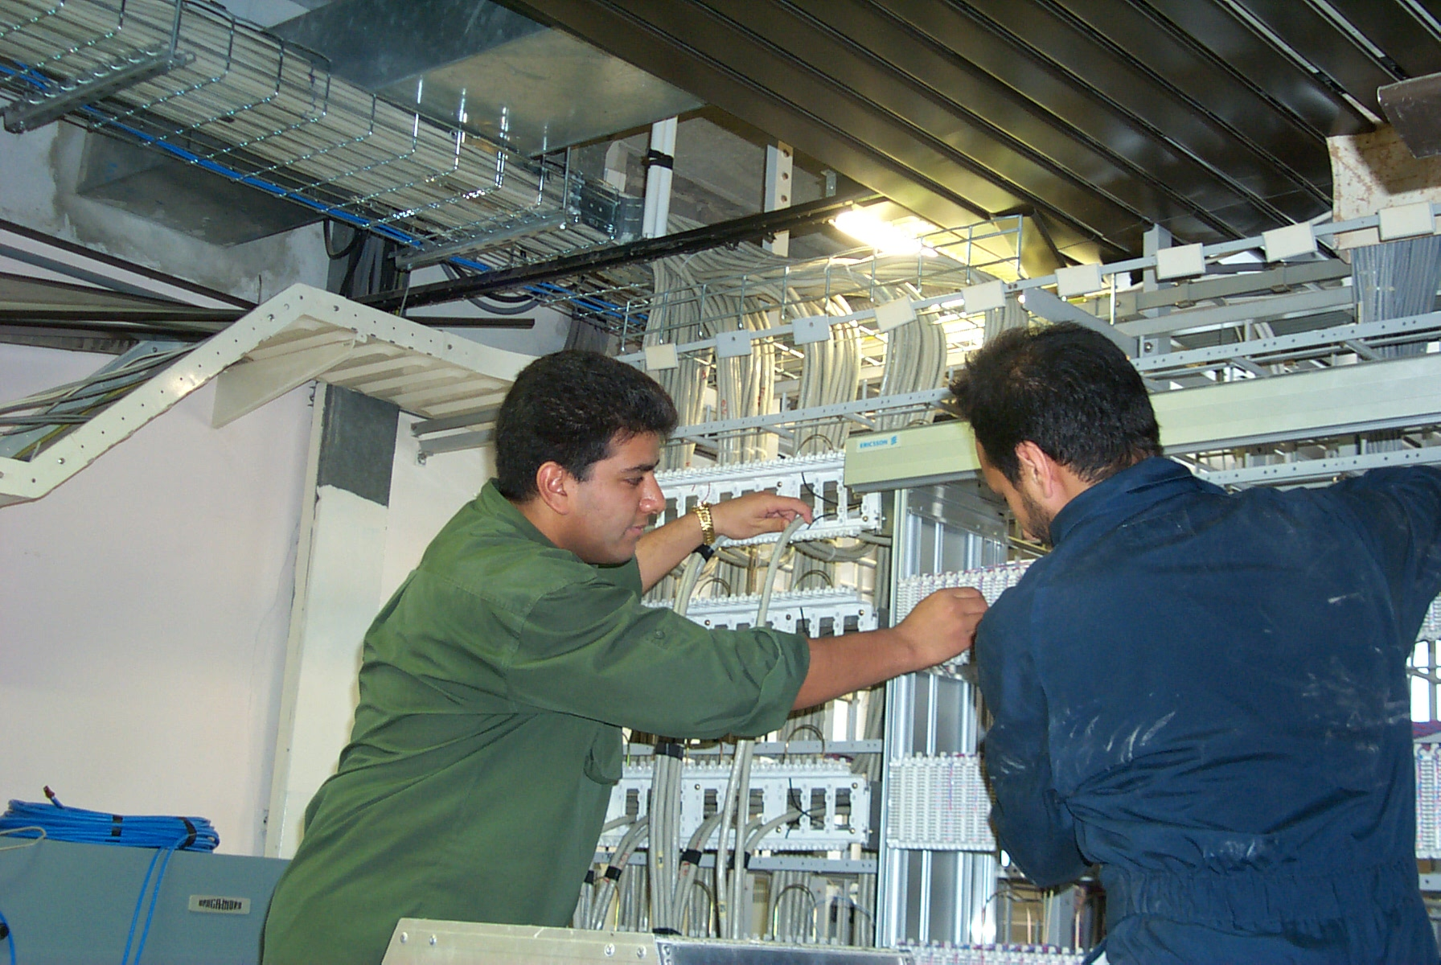
Company team
A professional team of Libyan engineers and technicians together with full range of foreign expert engineers fully deployed in the company and they are specialised in a full range of activities as follows:
Engineering and design
Project and Team Management
Installation & Commissioning
Support Service and Maintenance
Training
Benefits that you find in our company team:
A strong experience base in execution of projects all over the world especially in Libya.
Capability to provide integrated solutions.
Extensive and current knowledge of on-site work and procedures in Libya especially HSE requirements in oil fields.
A unique in-depth knowledge of technology trends.
A worldwide procurement capability

Slide 7
References (selected projects)
2004/2005
2005/2006
2006/2007
Agip Oil (Libya Branch):
Radio and Switching Network (EURO 700,000.00):
Our team was involved in Engineering, Procurement and Installation of a complete integrated Digital Microwave Systems to connect the operational Oil Fields in Bouri area (offshore), A100 area (Onshore), and Headquarter (Tripoli). The system consists of (6) complete Digital Microwave Radio Links (from Ericsson, Sweden & AReS, Italy) with Multiplexers (from AReS) fully integrated to Digital PBXs (from Ericsson) and Cisco Routers (for data). Our project team was involved throughout the project phases (Phase 1&2) under the supervision of the manufacturers (Ericsson and AReS). Our team was involved in Engineering, Design (by studying and identifying client requirements), project management, installation, and commissioning. The team gained a considerable high quality experience in execution of such projects. The two phases of the project were executed within 24 months on December 2004.
Eni Oil (Libyan Branch):
DP4 – DP3 – Slough Digital Radio Link (EURO 200,000.00):
Our team was involved in Engineering, and Installation of two Digital Radio Links (from AReS) connecting the offshore platforms DP4-DP3) and DP4-Slough Tanker (movable). Our engineers were involved in the installation activities under the supervision of AReS team. The installation works includes 0.6m Antenna assembly and alignment, coaxial cable installation, rack positioning etc.
A100 - UU - OO Digital Radio Link (EURO 100,000.00):
Our team was involved in Engineering, and Installation of two Digital Radio Links (from AReS) connecting the above-mentioned sites. Our engineers have finished the installation under the supervision of AReS on February 2006.The installation works includes: 3m Antenna assembly and alignment, coaxial cable installation, rack positioning etc.
Veba Oil Operations (now Al Harouge Oil Operations):
Material Supply & Technical Support (value: EURO 70,000.00):
Supply of fibre-optic cables, Computer Software, Hardware, and IT consumable items to purchase department (including: PCs, printers, accessories (hp), Switches (Cisco), and single/multimode direct buried fibre optic cables (Plasticavi).
Man Made River Authority:
(3) V-SAT Stations Installation:
Our company awarded this work for as a subcontractor to perform Installation & Commissioning of VSAT stations located in Tarhuna, Qaser Benghasher and Alqarboli (including the provision of telecom/data services.). The project execution took (2) months.

Slide 8
References (selected projects)
2007/2008
2008/2009
2010/2011
Eni Oil (Libyan Branch):
A100 – KP44 – Waha (Gialo59) Digital Radio Link (EURO 350,000.00):
Our company awarded this contract after tendering process and it was on a turnkey basis including: Engineering, Procurement and Installation of (2) Digital Microwave Radio Links (UNAOHM). The project execution took (6) months and our engineers have finished the installation on May 2008.
Wells International Company:
Network (LAN) Supply & Installation (value: EURO 10,000.00):
Our company awarded this job order for Engineering, Procurement and Installation of LAN in this company office in Tripoli (including 40: telephone/data nodes and switches PBX etc.). The project execution took (4) weeks and our engineers have finished the installation on September 2007.
Mellitah Oil & Gas B.V. Oil Division (Libyan Branch):
A100-KP44-Gialo59 Radio Links (value: EURO 345,000.00):
Our company awarded this contract after tendering process and it was in a turnkey basis as the sole local agent of AReS in Libya. We were involved in Engineering, Procurement and Installation of two Digital Radio Links connecting the above three sites (A100, KP44, and Gialo59) in the Libyan Desert. Our engineers have finished the installation under the supervision of AReS in November 2008 and continuing the follow-up and the support of this project to date. Follow-up and maintenance of any faulty part of AReS existing Digital Radio Links in the company sites (direct orders).
Dolphin Telecom (Ericsson Enterprise Partner):
Upgrade for MIN_LINKS from 1+0 to 1+1(value: EURO 20,000.00):
As a subcontractor, our installation team has performed the installation, commissioning and handover for the upgrade of (3) digital radio links (MIN-LINK E) for Mellitah Oil & Gas B.V. sites in Tripoli and Zawia. The project executed on time and successfully accepted by the client.
United Nation Development Program (UNDP):
Material Supply & Technical Support (value: EURO 70,000.00):
Our company has performed some orders to supply technology related items such as Acer computers, Hp servers, CISCO network switches etc. This was part of Ministry Of Justice and Security (MOJS) Infrastructure Project. The supply of material was on time and the technical support accomplished professionally.
Arab Geophysical Exploration Service Company (AGESCO):
Installation of Vehicle Tracking System (value: EURO 5,000.00):
Our company participated in the installation activity under the supervision of ROAMWORKS system for tracking vehicles across the Libyan Desert. The system designed using Satellite Tracking Technology.

Slide 9
References (selected projects)
2012/2013
2014/2015
2016/2017
Arabian Gulf Oil Company (AGOCO):
Material Supply (value: EURO 15,000.00):
Our company awarded an order to supply HF Radio (BARRATTE) and successfully done in remarkable time.
Mabruk Oil Operations:
Vehicle Tracking System for company cars (yearly rent value: US$ 120,000.00):
Our company awarded service order to rent installed company cars tracking system supplied by ROAMWORKS (http://roamworks.com/) in Tripoli area and desert sites. Our technical team was involved in design procurement, installation and commissioning of the system. As per the agreement, our company operated the system on rental basis for (3) years then the ownership has been moved to Mabruk Oil.
Arabian Gulf Oil Company (AGOCO):
Material Supply (value: LYD 35,000.00):
Our company awarded an order to supply VHF ground to air radios (Icom) and successfully finished in remarkable time.
Mabruk Oil Operations:
Tender for Digital microwave Link BD1-FPSO Supply and Services (value: EURO 555,000.00):
Our company tendered for this project and our technical offer was short listed, but, after more than (2) years of tendering, clarifications, and presentations, we have been informed that our company was not selected for the commercial competition and it could be due to the current situation in Libya the project was suspended because of budget cuts. The technical & commercial project documentation that was prepared during offering includes: Engineering, Procurement, Installation, and Commissioning (Turn-key basis). It was in partnership with Sferiacom s.r.l. (http://www.sferia.com/) for engineering, design, integration, and supply of a full redundant digital microwave radio link to connect the (2) offshore sites BD1 and FPSO which is floating tanker (a complete antenna tracking system).
LIBYANA (GSM Operator):
Provision of Technical Team to install, Manage and commission of Gemalto Servers (EURO20,000.00):
Our company awarded a subcontract from a contractor of LIBYANA: Mobinet (http://www.mobinets.com/) to outsource high tech local team (IBM, Linux certified specialists) to install, IP configure, manage, and commission gemalto (www.gemalto.com) servers. Also, perform site tests on SIM cards. The job was done in a very professional way and the system was installed, tested, and, handed over successfully.
Arabian Gulf Oil Company (AGOCO):
Material Supply (value: EURO 15,000.00):
Our company was awarded some orders to supply technology related materials such as HF radios, digital radio links, hp computers, and so on.

Slide 10
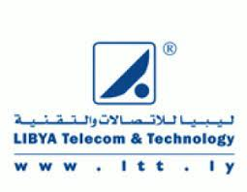
TELECOM clients

Slide 11
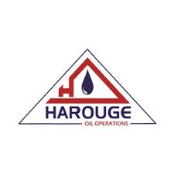
oil clients

Slide 12
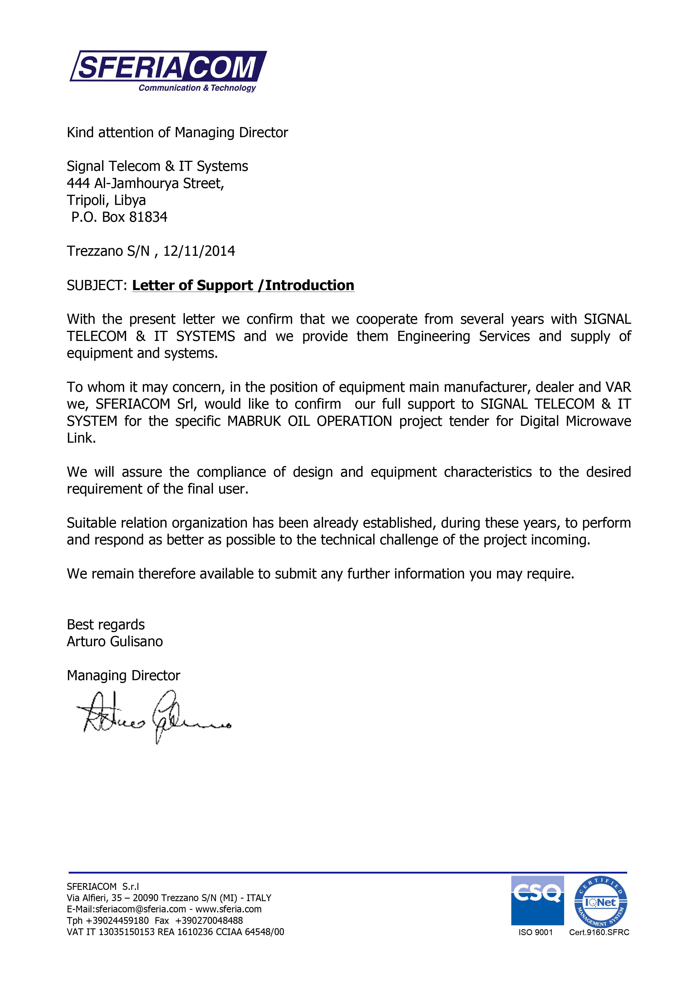
International partners
Main Strategic Partners:
Sferia Communication & Technology (www.sferia.com)
UNAOHM Radio systems, Italy (www.unaohm.it)
Other Partners:
Alphaelettronica (www.alphaelettronica.com)
FlexDSL, Swizerland (www.flexdsl.ch)
ROHDE & SCHWARZ (www. rsd.rohde-schwarz.com)
Microwave Networks, USA (www.microwavenetworks.com)
Hp, U.S.A (www.hp.com)
Teraspan Networks, Canada (www.terspan.com)

Slide 13
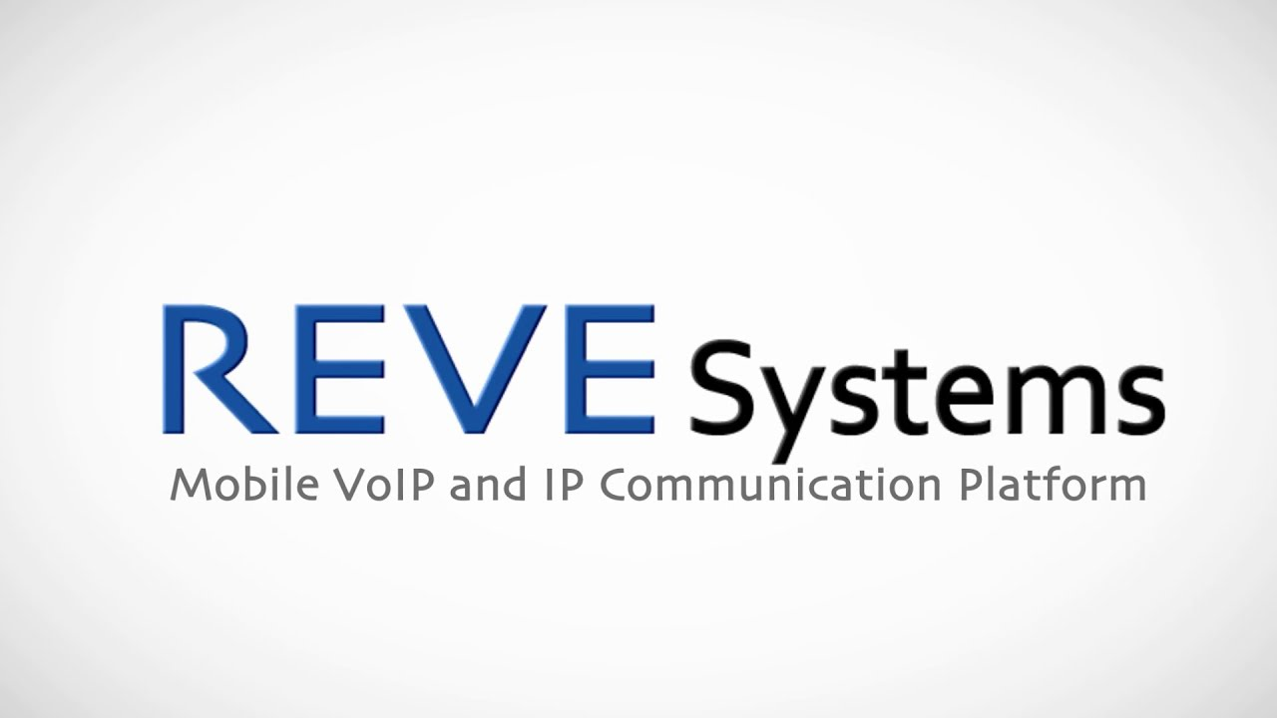
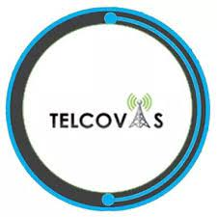
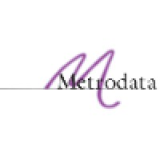
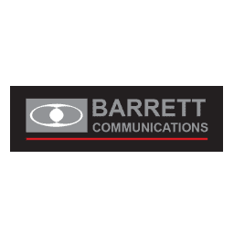
technology& Products

Slide 14
contact
Main Office: Attufail Ben Amr Street, Ben Ashore,
P.O. Box 81834, Tripoli, Libya
Phone/Fax: +218 21 3636311
E-mail:
ceo@d-signal.com (CEO) +218 91 2110394
cto@d-signal.com (CTO) +218 91 7165901
info@d-signal.com (for general enquiries)
Web: www.d-signal.com

